Slide 1

ESTIMATION OF SCALE PARAMETER FOR CAUCHY DISTRIBUITION ~ A MOMENT BASED APPROCH
Debapriyo Bhar
Arkabrata Mondal
Debajyoti Roy

Slide 2

INTRODUCTION
We often work with heavy tailed distribution and the Cauchy distribution is a classic example where standard estimators like MLE & QD may fail.
Since integer moments do not exist for the Cauchy distribution, we estimate scale parameter using fractional moments.
We also run a simulation experiment for comparison and watch that there exists a range of order for which our estimator performs much better than other existing estimators (quartile deviation, maximum likelihood estimator) in respect to absolute bias, mean square error(MSE).

Slide 3
OUR OBJECTIVES
To understand the statistical challenges in estimating the parameters of the Cauchy distribution, particularly the scale parameter σ.
To explore and implement fractional moment-based estimators for the scale parameter and study about the limiting behaviour of these estimators.
To assess estimator performance through simulation studies in R using metrics like bias and mean squared error (MSE).

Slide 4
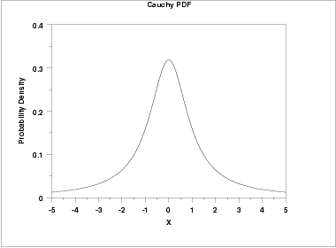

Cauchy Distribution
As we know ,integer moments of the Cauchy distribution does not exist. Therefore , when estimating the scale parameter of a Cauchy distribution, we approach it using fractional moments.
The Cauchy distribution is a continuous probability distribution with location parameter µ and scale parameter σ , defined by the probability density function:
$$f\left(x;μ,σ\right)=\frac{1}{πσ}⋅\frac{1}{1+{\left(\frac{x−μ}{σ}\right)}^{2}}, x∈R$$

Slide 5
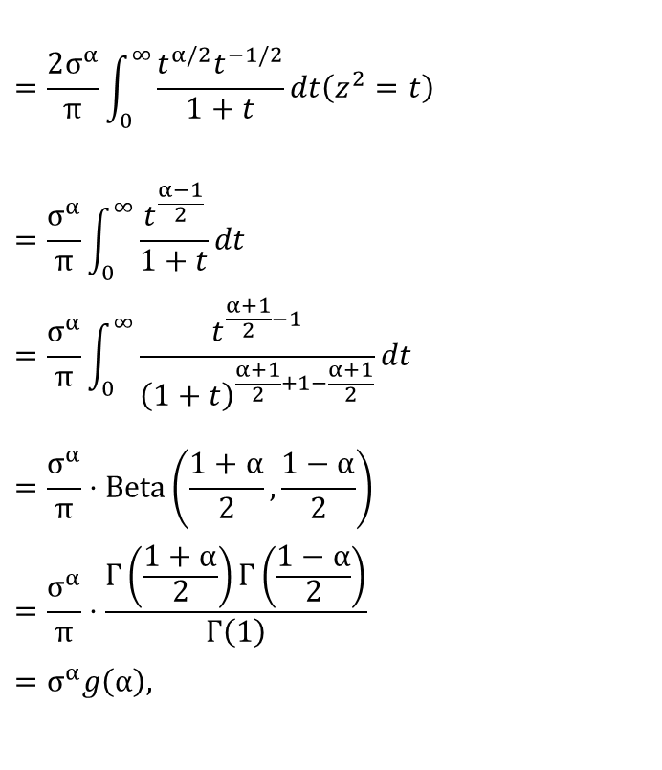
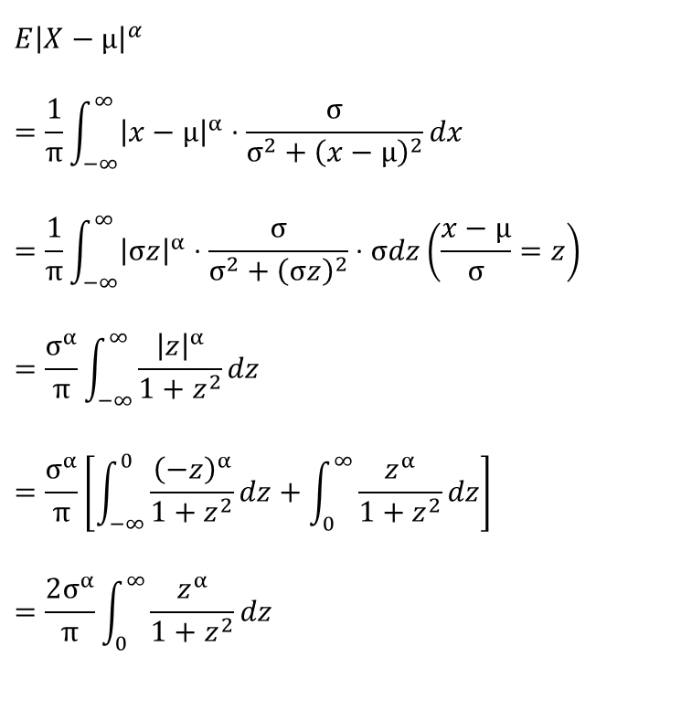

Our approach: Fractional moment
We calculate,
$$=\frac{2σ^{α}}{π}\int_{0}^{∞}{\frac{t^{α/2}t^{−1/2}}{1+t}}dt\left(z^{2}=t\right)$$
$$=\frac{σ^{α}}{π}\int_{0}^{∞}{\frac{t^{\frac{α−1}{2}}}{1+t}}dt$$
$$=\frac{σ^{α}}{π}\int_{0}^{∞}{\frac{t^{\frac{α+1}{2}−1}}{{\left(1+t\right)}^{\frac{α+1}{2}+1−\frac{α+1}{2}}}}dt$$
$$=\frac{σ^{α}}{π}⋅\text{Beta}\left(\frac{1+α}{2},\frac{1−α}{2}\right)$$
$$=\frac{σ^{α}}{π}⋅\frac{Γ\left(\frac{1+α}{2}\right)Γ\left(\frac{1−α}{2}\right)}{Γ\left(1\right)}$$
$$=σ^{α}g\left(α\right),$$
$${E\left|X−μ\right|}^{α}$$
$$=\frac{1}{π}\int_{−∞}^{∞}{{\left|x−μ\right|}^{α}}⋅\frac{σ}{σ^{2}+{\left(x−μ\right)}^{2}}dx$$
$$=\frac{1}{π}\int_{−∞}^{∞}{{\left|σz\right|}^{α}}⋅\frac{σ}{σ^{2}+{\left(σz\right)}^{2}}⋅σdz\left(\frac{x−μ}{σ}=z\right)$$
$$=\frac{σ^{α}}{π}\int_{−∞}^{∞}{\frac{{\left|z\right|}^{α}}{1+z^{2}}}dz$$
$$=\frac{σ^{α}}{π}\left[\int_{−∞}^{0}{\frac{{\left(−z\right)}^{α}}{1+z^{2}}}dz+\int_{0}^{∞}{\frac{z^{α}}{1+z^{2}}}dz\right]$$
$$=\frac{2σ^{α}}{π}\int_{0}^{∞}{\frac{z^{α}}{1+z^{2}}}dz$$
$[α∈\left(−1,0\right)∪\left(0,1\right).$]

Slide 6

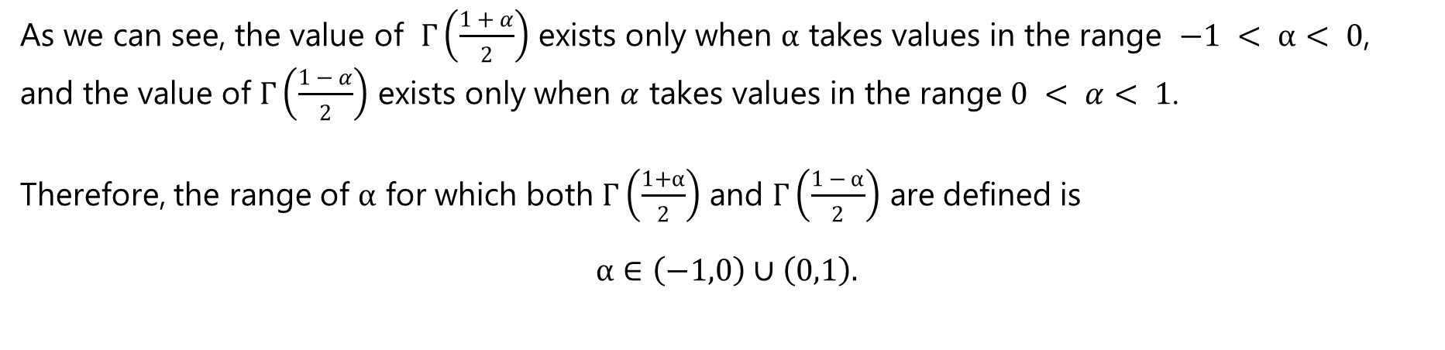
As we can see, the value of $Γ\left(\frac{1 + α}{2}\right)$ exists only when $α$ takes values in the range $−1 < α< 0$,
and the value of $Γ\left(\frac{1 − α}{2}\right)$ exists only when $α$ takes values in the range $0 < α< 1$.
Therefore, the range of $α$ for which both $Γ\left(\frac{1+α}{2}\right)$ and $Γ\left(\frac{1 − α}{2}\right)$ are defined is
$$α∈\left(−1,0\right)∪\left(0,1\right).$$
where,
$$g\left(α\right)=\frac{1}{π}Γ\left(\frac{1+α}{2}\right)Γ\left(\frac{1−α}{2} \right)=\frac{1}{\cos\left(απ/2\right)}$$
[Euler’s reflection formula]

Slide 7
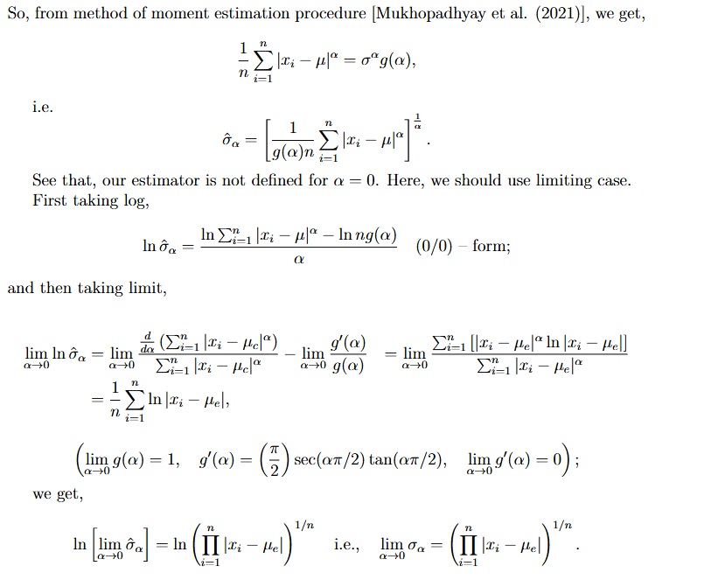

Slide 8
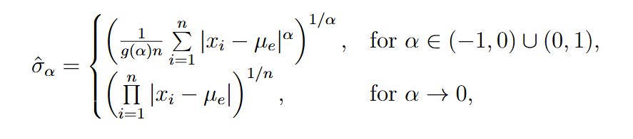

So, our proposed estimator is given by

Slide 9

To evaluate the effectiveness of our estimator, we compare it with the QD and MLE
Quartile Deviation :
QD considers only central half of data, ignoring remaining half (i.e., not amenable to algebraic treatment).
Maximum Likelihood Estimate:
MLE estimate can be heavily biased for small
samples. MLE is not robust to outliers.

Slide 10


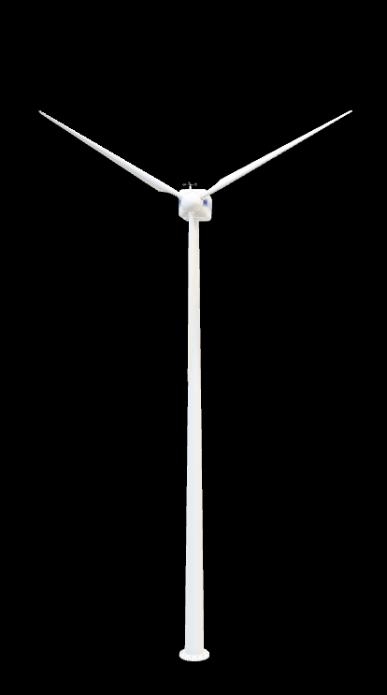
Evaluation Metrics
For each estimator, the following statistical properties were computed:
Bias:
$Bias=E\left[\hat{σ}\right]−$ $σ$
Mean Squared Error (MSE):
$$\text{MSE}=E\left[{\left(\hat{σ}−σ\right)}^{2}\right]$$
These metrics were used to evaluate the accuracy and consistency of each estimator under repeated sampling from the Cauchy distribution.

Slide 11
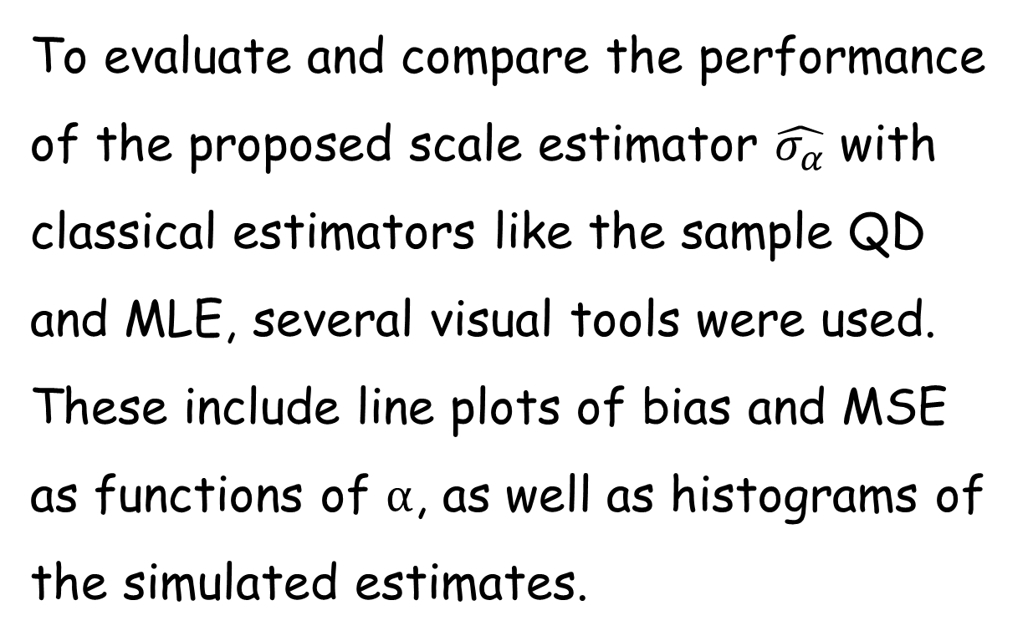
Visualisation of Results
To evaluate and compare the performance of the proposed scale estimator $\hat{σ_{α}}$ with classical estimators like the sample QD and MLE, several visual tools were used. These include line plots of bias and MSE as functions of $α$, as well as histograms of the simulated estimates.

Slide 12





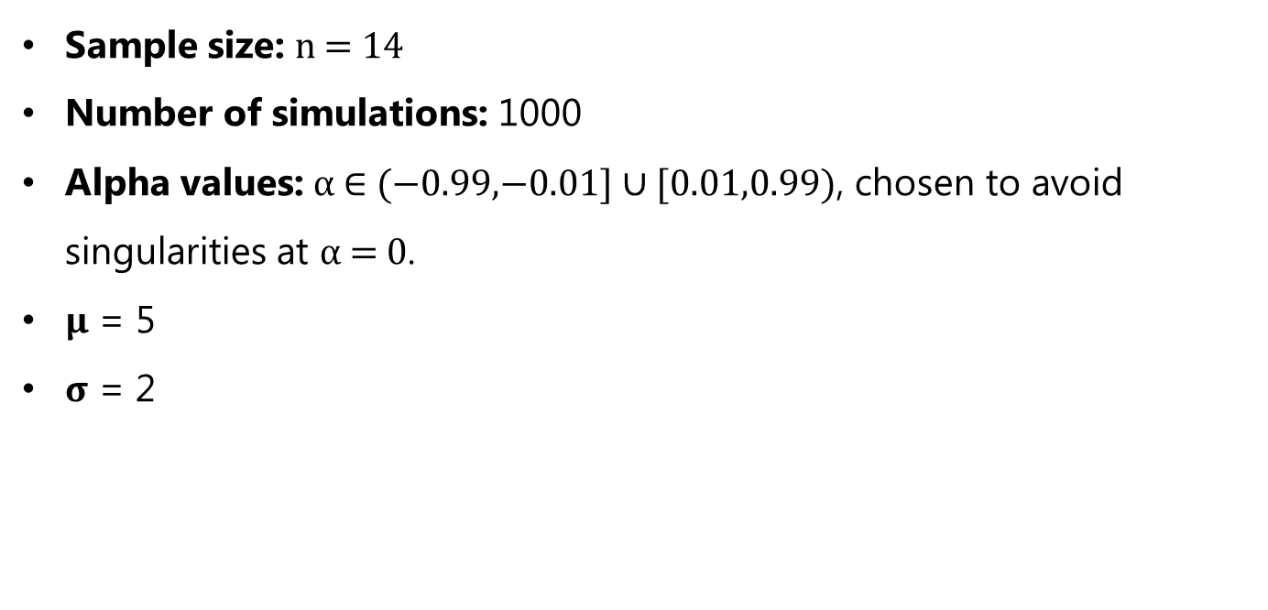
Implementation in R
Simulation details
Sample size: n = 14
Number of simulations: 1000
Alpha values: α ∈ (−0.99,−0.01] ∪ [0.01,0.99), chosen to avoid singularities at α = 0.
$μ$ = 5
$σ$ = 2

Slide 13

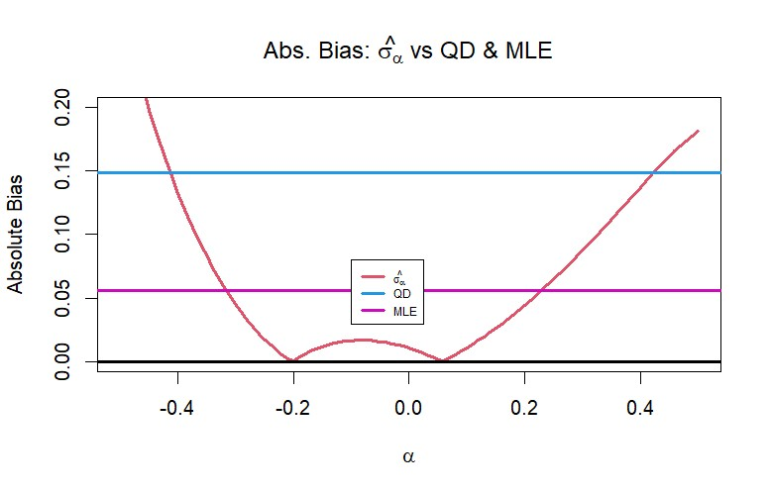
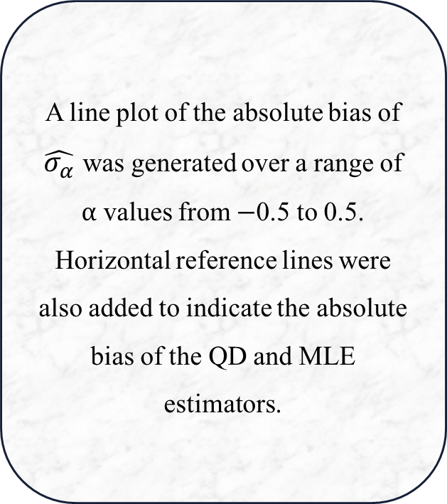
Absolute Bias vs α
A line plot of the absolute bias of $\hat{σ_{α}}$ was generated over a range of α values from −0.5 to 0.5. Horizontal reference lines were also added to indicate the absolute bias of the QD and MLE estimators.

Slide 14


• The minimum absolute bias of the proposed estimator was observed near α = 0.06.
• This result outperformed both QD and MLE estimators.
• The plot showed a clear U-shape, suggesting that careful selection of α improves estimator performance.

Slide 15
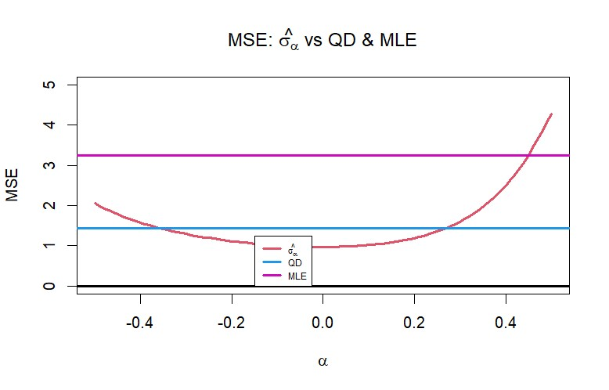
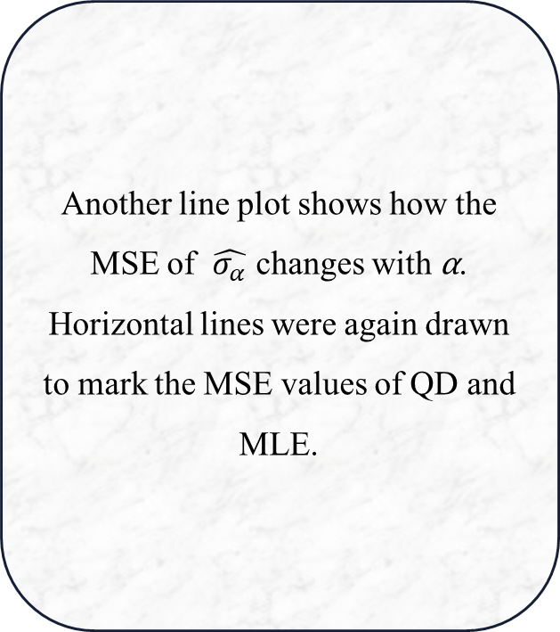
Mean Squared Error (MSE) vs α
Another line plot shows how the MSE of $\hat{σ_{α}}$ changes with α. Horizontal lines were again drawn to mark the MSE values of QD and MLE.

Slide 16
• The minimum absolute MSE of the proposed estimator was observed near α = 0.
• This result outperformed both QD and MLE estimators.
• The plot showed a clear U-shape, suggesting that careful selection of α improves estimator performance.
These visual comparisons confirm that the proposed estimator is more reliable and accurate when the tuning parameter α is appropriately chosen.

Slide 17
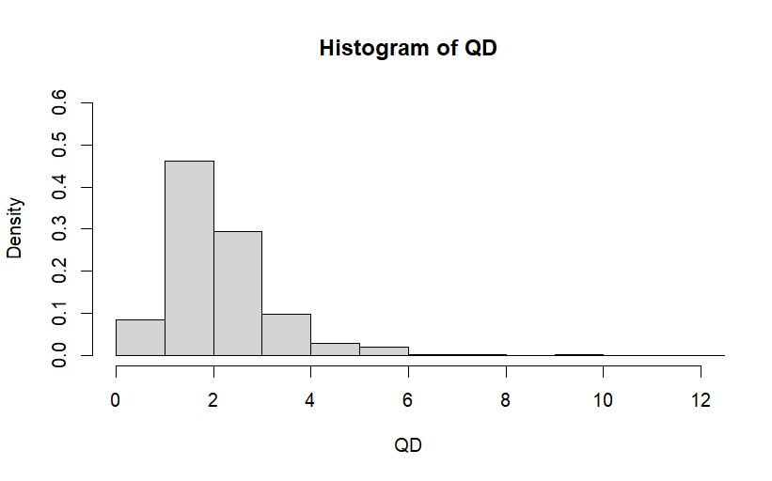
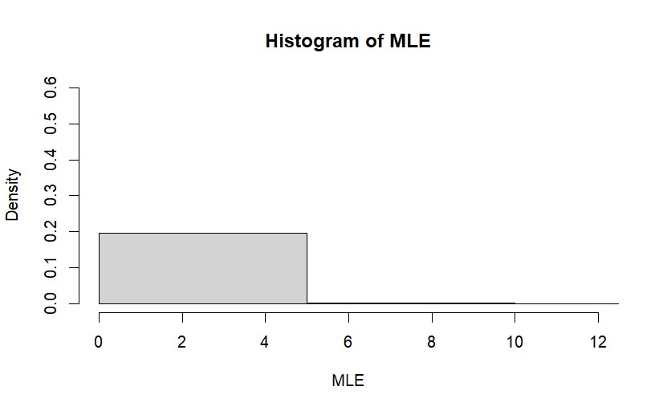
Histograms of Estimators
(a) Histogram of QD Estimator
(b) Histogram of MLE Estimator

Slide 18
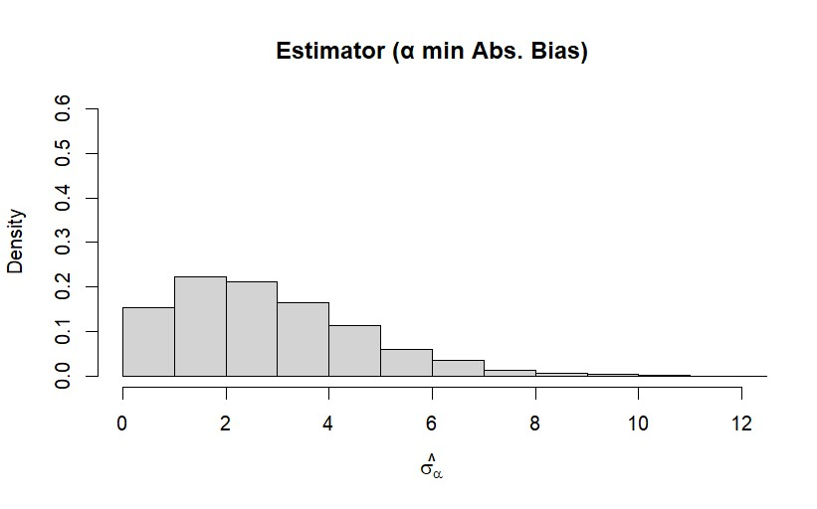
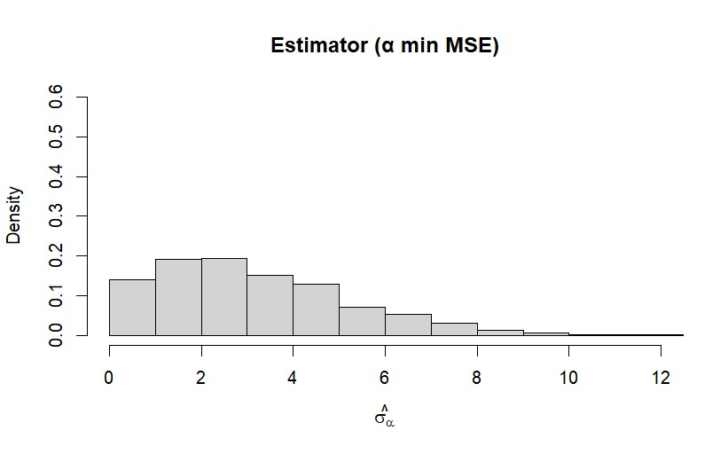
Performance Plots of Estimators
(a) Estimator with Minimum Absolute Bias
(b) Estimator with Minimum MSE

Slide 19



The QD estimator exhibited a moderate concentration near the true value but with a noticeable right skew and moderate spread, reflecting its sensitivity to sample variation
The MLE estimator showed a strong peak around the true scale but had a very heavy tail, indicating occasional extreme outliers that increase its variance.
The proposed estimator $\hat{σ_{α}}$ (for α minimizing bias and MSE) showed:
- Strong concentration around $σ$=2 with little skew.
- A more balanced distribution compared to both QD and MLE.
These visual comparisons confirm that the proposed estimator is more reliable and accurate when the tuning parameter α is appropriately chosen.

Slide 20
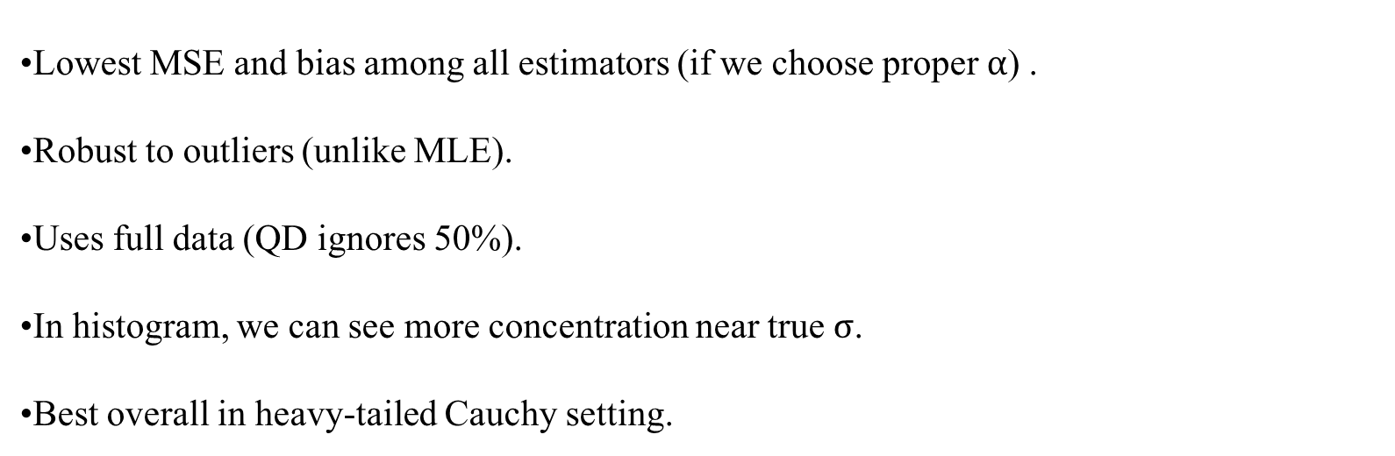
Beyond QD and MLE: Justifying Our Estimate Choice
Lowest MSE and bias among all estimators (if we choose proper $α$) .
Robust to outliers (unlike MLE).
Uses full data (QD ignores 50%).
In histogram, we can see more concentration near true σ.
Best overall in heavy-tailed Cauchy setting.

Slide 21

Conclusion
Classical estimators like MLE and QD perform poorly for Cauchy due to undefined mean and variance. Our fractional-based estimators remain well-defined and robust under such heavy-tail condition.
The fractional moment estimation and approach can be adapted to distributions like Levy or stable distributions, where integer moment does not exist.
We can extend this univariate estimator to a multivariate setup, enabling robust scale and covariance estimation for multivariate Cauchy distributions.

Slide 22

THANK YOU

